Slide 1
Simplifications of
Context-Free Grammars

Slide 2
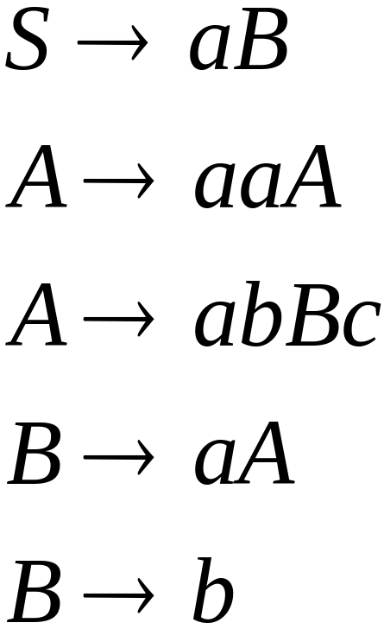
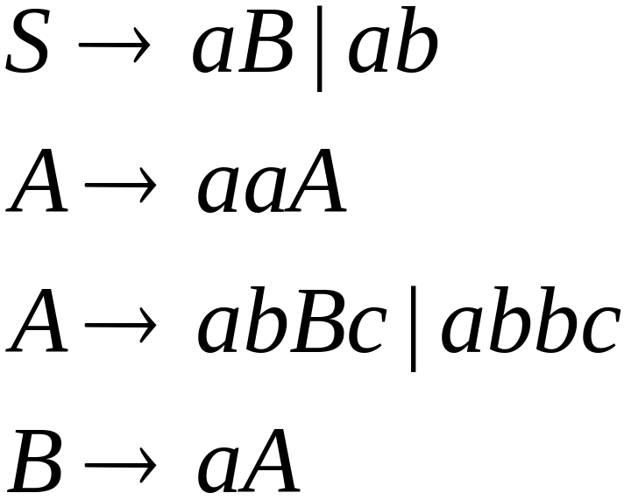

A Substitution Rule
Equivalent
grammar
Substitute

Slide 3


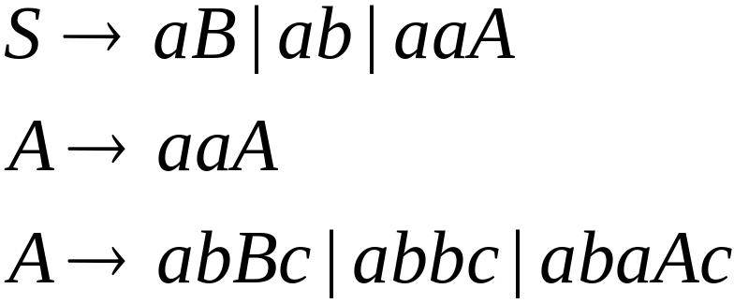
A Substitution Rule
Substitute
Equivalent
grammar

Slide 4
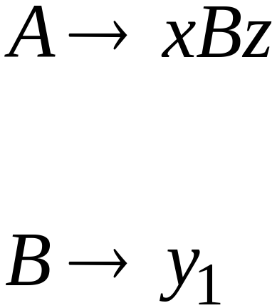
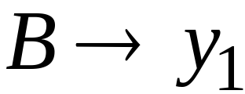
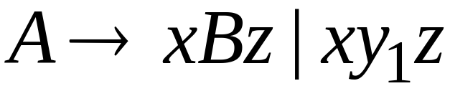
In general:
Substitute
equivalent
grammar

Slide 5
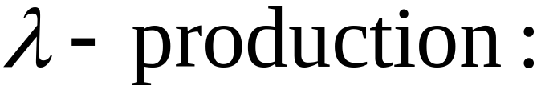


Nullable Variables
Nullable Variable:

Slide 6
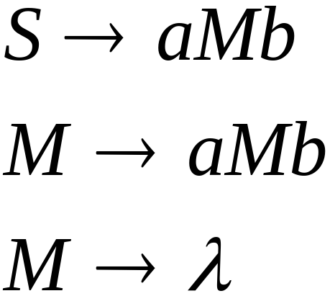
Removing Nullable Variables
Example Grammar:
Nullable variable

Slide 7
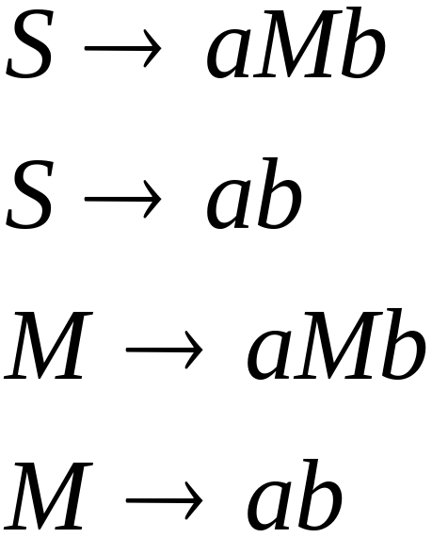

Final Grammar
Substitute

Slide 8

Unit-Productions
Unit Production:
(a single variable in both sides)

Slide 9

Removing Unit Productions
Observation:
Is removed immediately

Slide 10
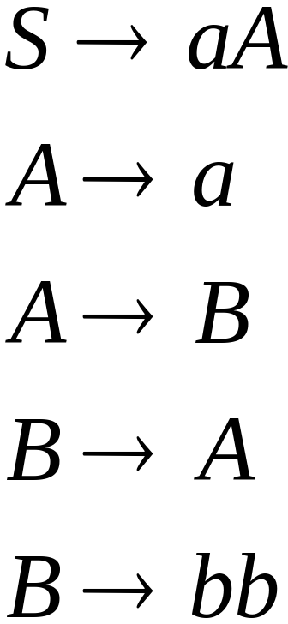
Example Grammar:

Slide 11
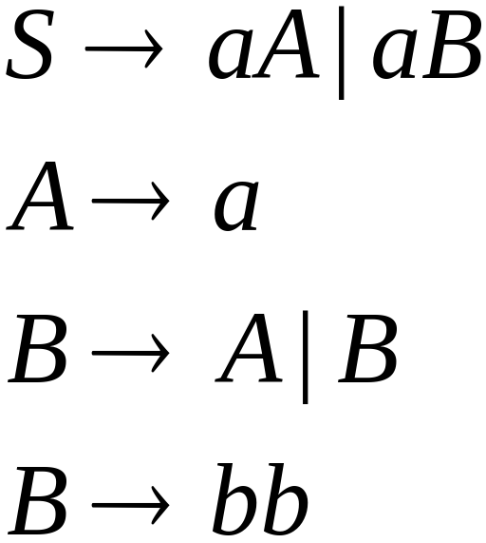

Substitute

Slide 12
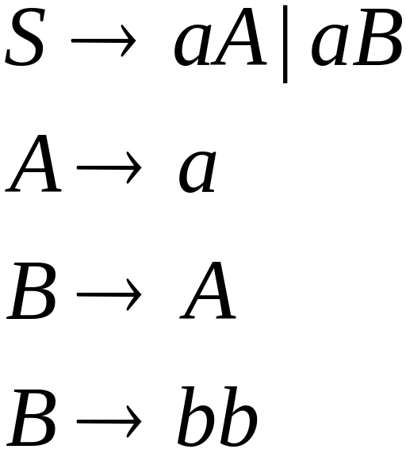

Remove

Slide 13
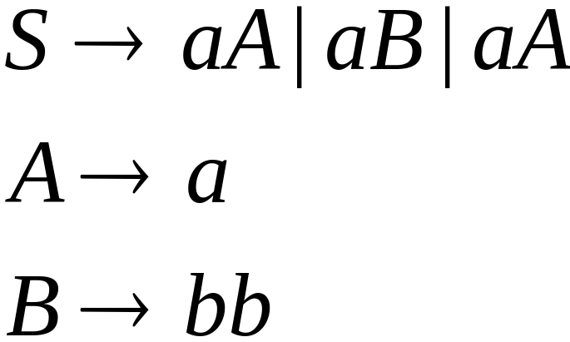

Substitute

Slide 14
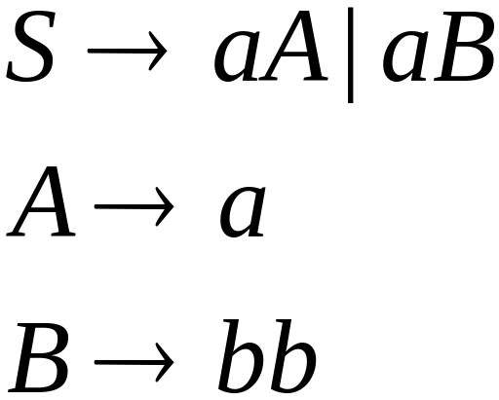
Remove repeated productions
Final grammar

Slide 15
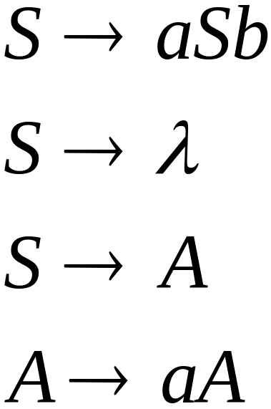
Useless Productions
Useless Production
Some derivations never terminate...

Slide 16
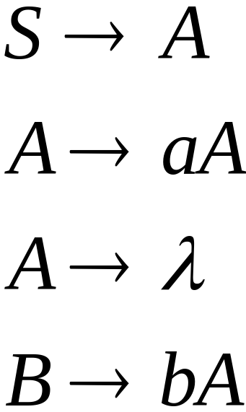
Another grammar:
Useless Production
Not reachable from S

Slide 17



In general:
contains only
terminals
if
then variable is useful
otherwise, variable is useless

Slide 18

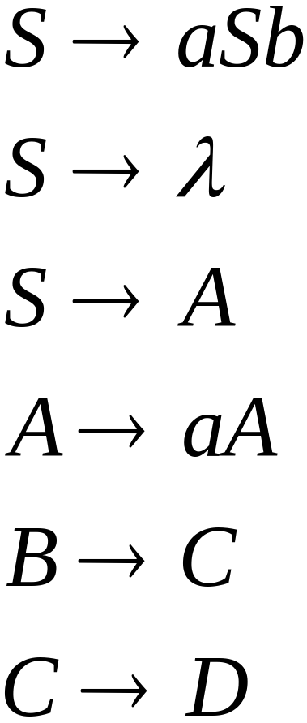
A production is useless
if any of its variables is useless
Productions
Variables
useless
useless
useless
useless
useless
useless
useless

Slide 19
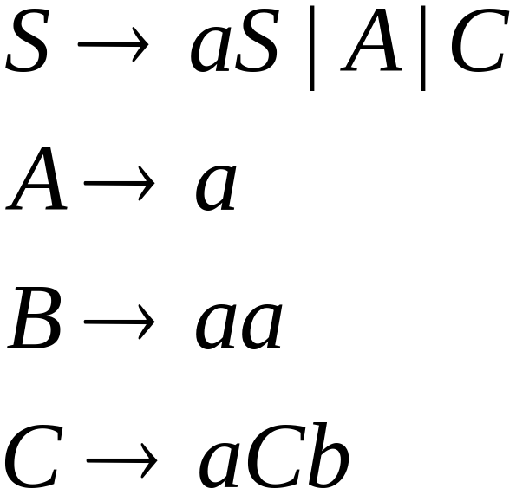
Removing Useless Productions
Example Grammar:

Slide 20
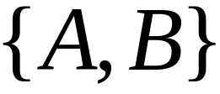

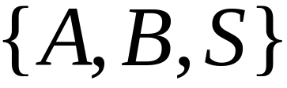
First:
find all variables that can produce
strings with only terminals
Round 1:
Round 2:

Slide 21
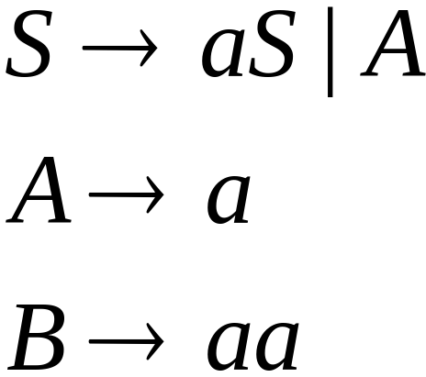
Keep only the variables
that produce terminal symbols:
(the rest variables are useless)
Remove useless productions

Slide 22




Second:
Find all variables
reachable from
Use a Dependency Graph
not
reachable

Slide 23
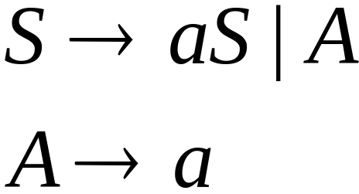
Keep only the variables
reachable from S
(the rest variables are useless)
Final Grammar
Remove useless productions

Slide 24
Removing All
Step 1: Remove Nullable Variables
Step 2: Remove Unit-Productions
Step 3: Remove Useless Variables

Slide 25
Normal Forms for
Context-free Grammars

Slide 26


Chomsky Normal Form
Each productions has form:
or
variable
variable
terminal

Slide 27
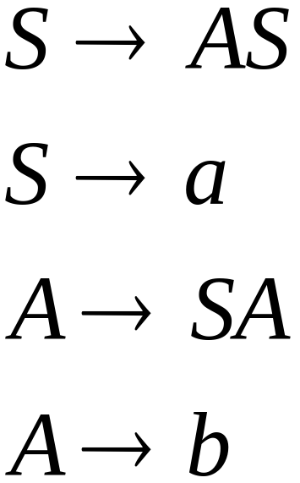
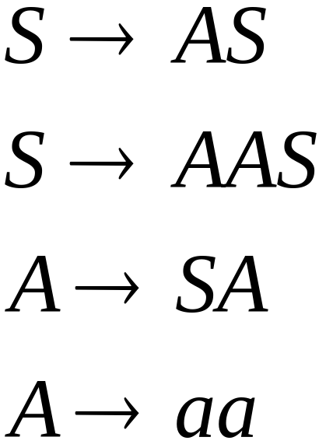
Examples:
Chomsky
Normal Form
Not Chomsky
Normal Form

Slide 28
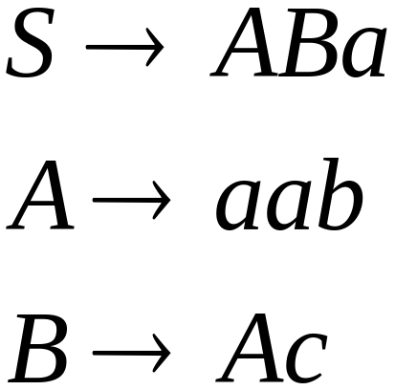
Convertion to Chomsky Normal Form
Example:
Not Chomsky
Normal Form

Slide 29
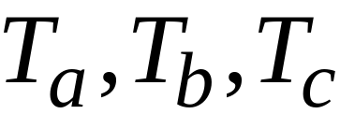
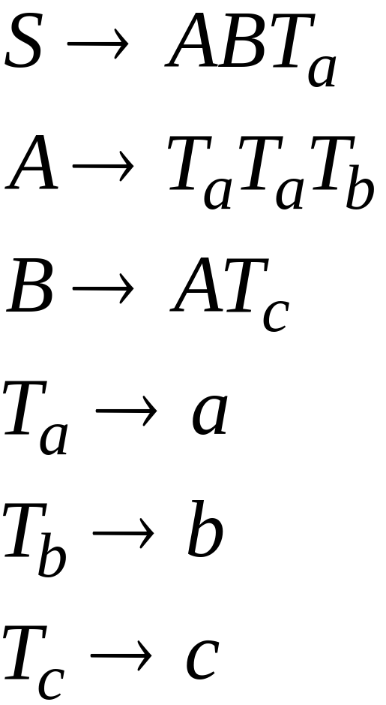
Introduce variables for terminals:

Slide 30

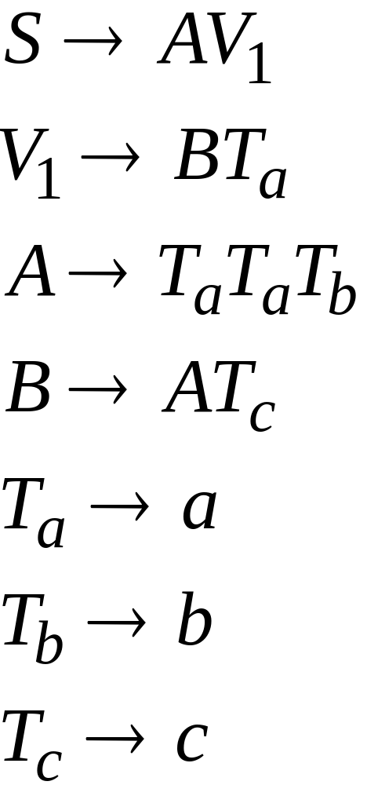
Introduce intermediate variable:

Slide 31
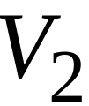
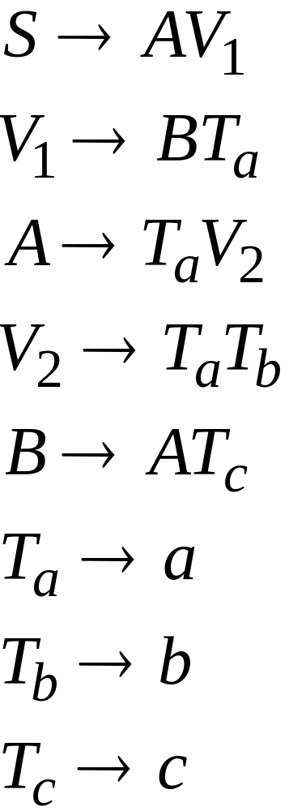
Introduce intermediate variable:

Slide 32
Final grammar in Chomsky Normal Form:
Initial grammar

Slide 33

In general:
From any context-free grammar
(which doesn’t produce )
not in Chomsky Normal Form
we can obtain:
An equivalent grammar
in Chomsky Normal Form

Slide 34
The Procedure
First remove:
    Nullable variables
    Unit productions

Slide 35

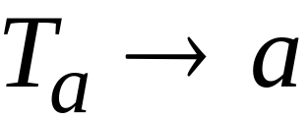

Then, for every symbol :
Add production
In productions: replace with
New variable:

Slide 36
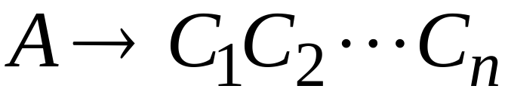
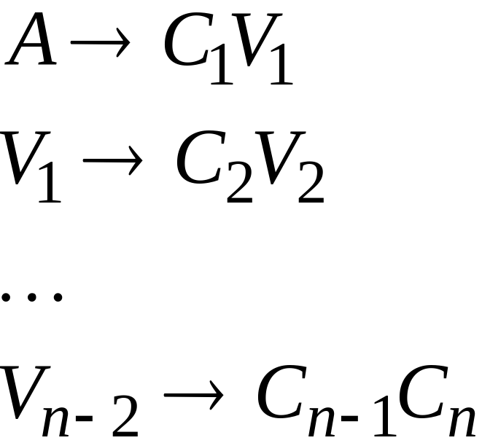
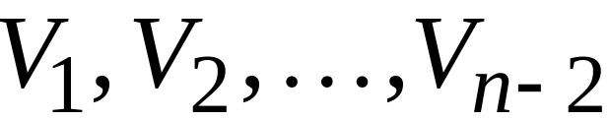
Replace any production
with
New intermediate variables:

Slide 37

Theorem:
For any context-free grammar
(which doesn’t produce )
there is an equivalent grammar
in Chomsky Normal Form

Slide 38
Observations
Chomsky normal forms are good
for parsing and proving theorems
It is very easy to find the Chomsky normal
form for any context-free grammar

Slide 39
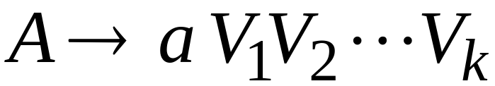

Greinbach Normal Form
All productions have form:
symbol
variables

Slide 40
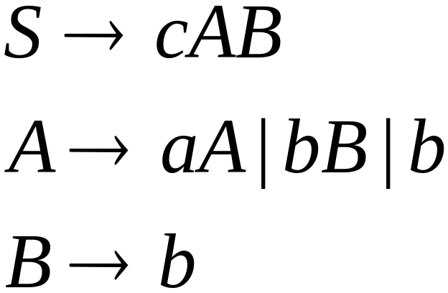
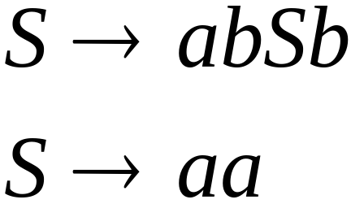
Examples:
Greinbach
Normal Form
Not Greinbach
Normal Form

Slide 41
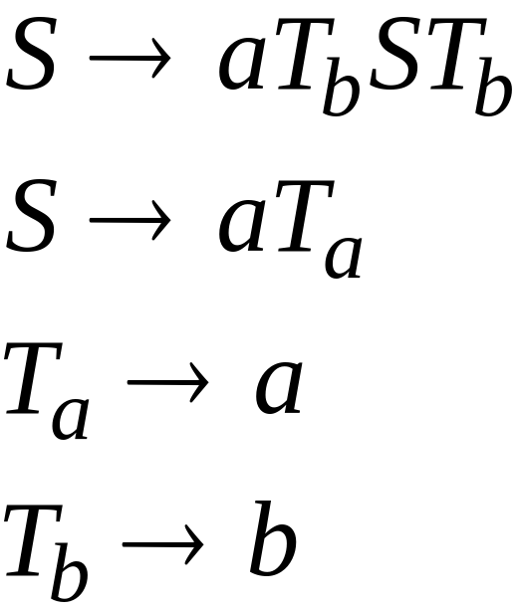
Conversion to Greinbach Normal Form:
Greinbach
Normal Form

Slide 42
Theorem:
For any context-free grammar
(which doesn’t produce )
there is an equivalent grammar
in Greinbach Normal Form

Slide 43
Observations
Greinbach normal forms are very good
for parsing
It is hard to find the Greinbach normal
form of any context-free grammar

Slide 44
The CYK Parser

Slide 45


The CYK Membership Algorithm
Input:
Grammar in Chomsky Normal Form
String
Output:
find if

Slide 46
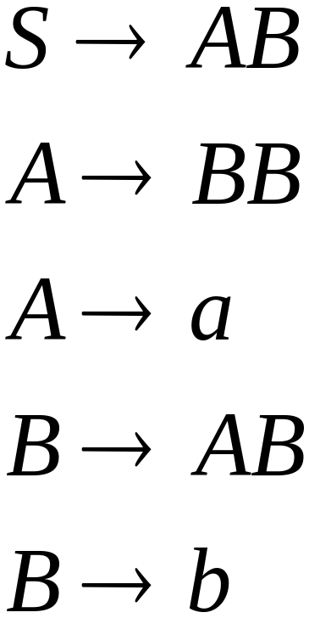

The Algorithm
Input example:
Grammar :
String :

Slide 47
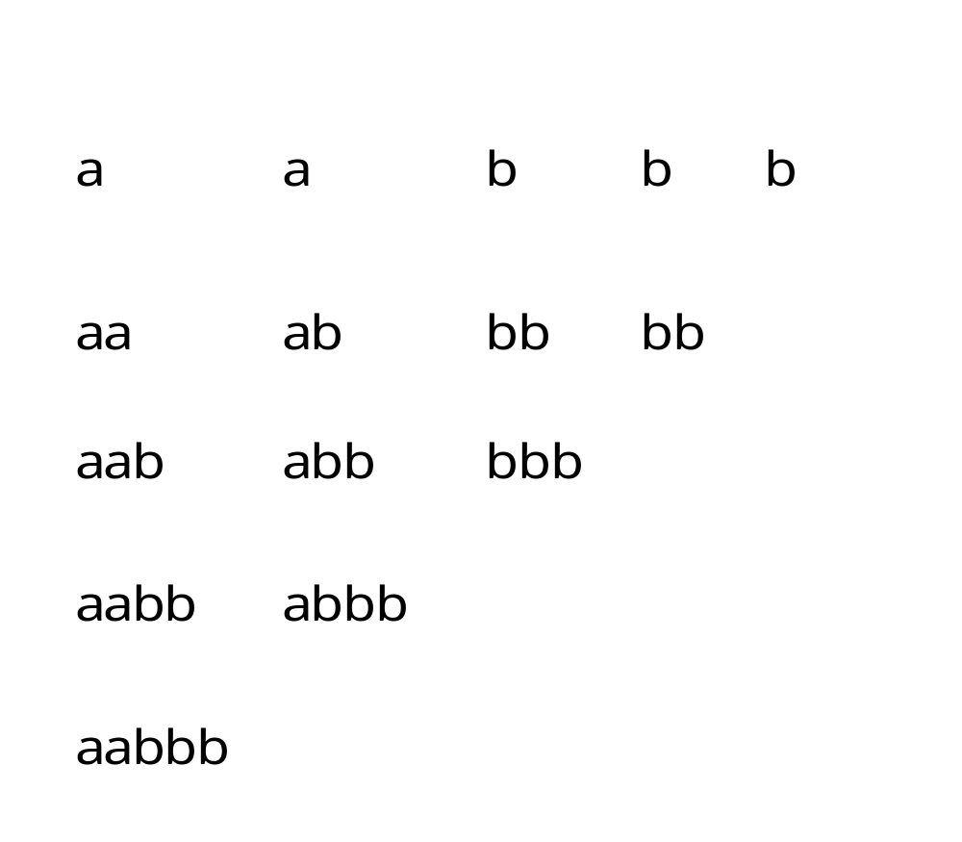

Slide 48
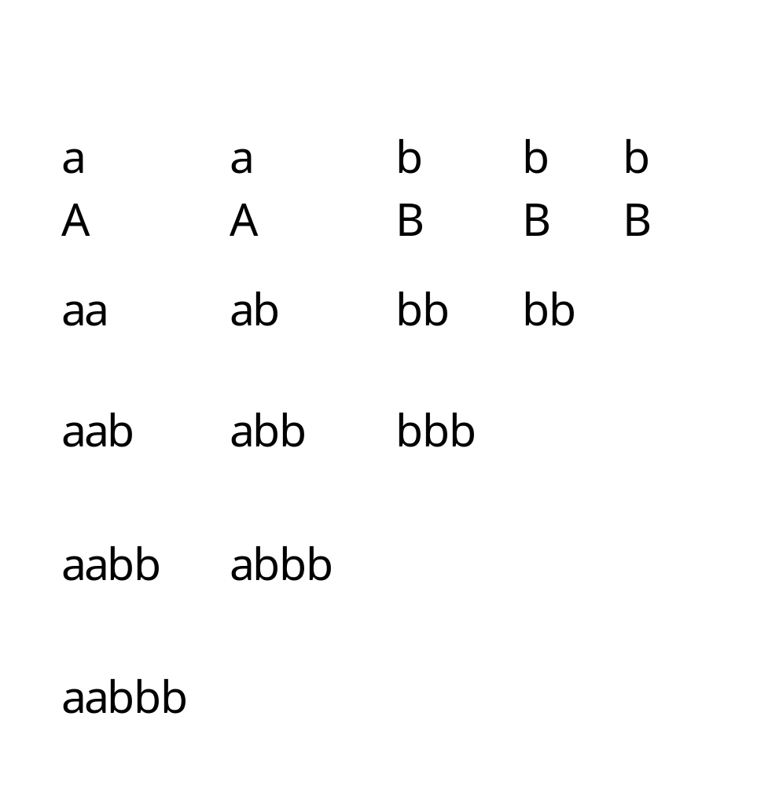

Slide 49
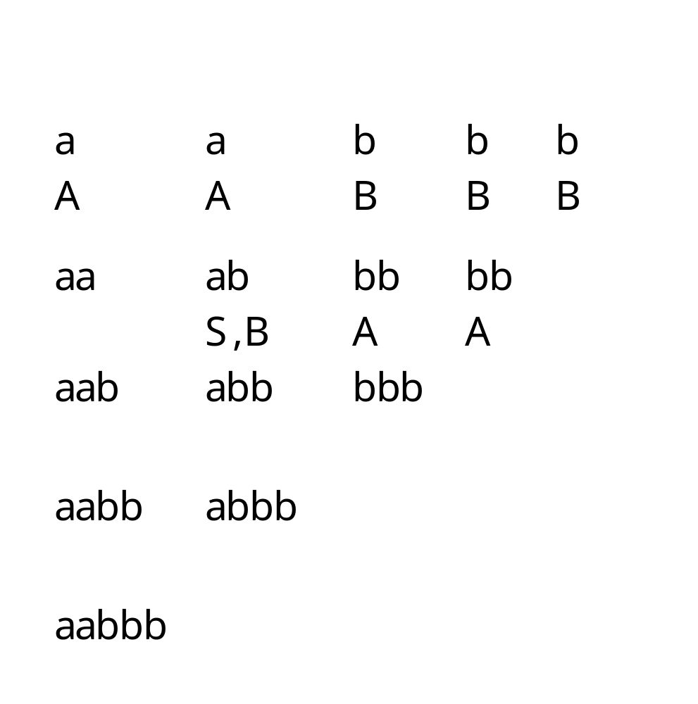

Slide 50
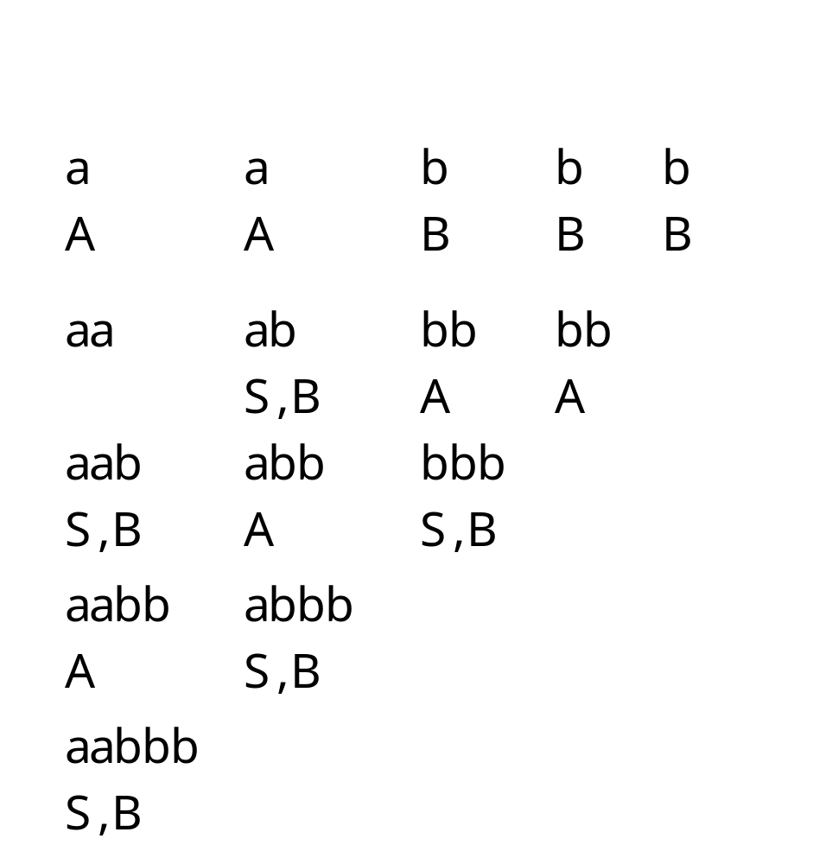
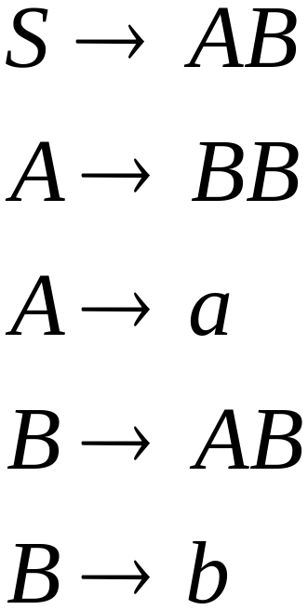

Slide 51
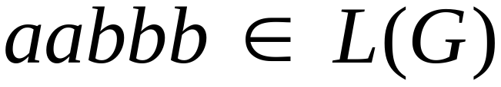
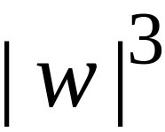
Therefore:
Time Complexity:
Observation:
The CYK algorithm can be
easily converted to a parser
(bottom up parser)

